Slide 1
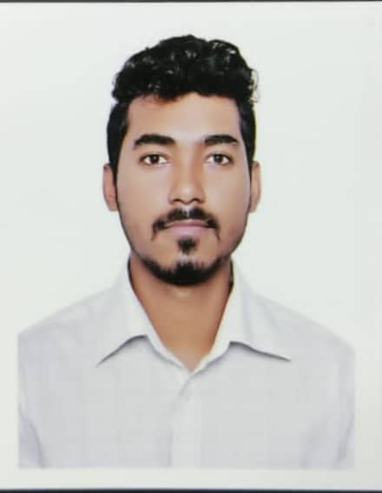






PARTHA BARUA
CONTACT
ABOUT ME
872/B Battery goli, dampara, Chattogram
Aiming at the employment where hard work, strong sense responsibility, self-motivated, willingness for public dealing an career building job I my field of development, research, management, administration.
01863795568
01940048256
Parthobarua776@gmail.com
SKILLS
MS WORD
EDUCATION
MS EXCEL
M.B.A (2019-2020)
Government commerce college. Chattogram.
Accounting
National University
MS POWERPOINT
FAST TYPING
LANGUAGE
B.B.A (2015-2016)
Omar Gani M.E.S university college. Chattogram.
Accounting
3.03 ( out of 4 )
National University
BANGLA
ENGLISH
Higher Secondary Certificate (H.S.C) (2015)
Municipal Model School & college. Chattogram.
Business Studies
2.80 ( out of 5 )
Chattogram
STRENGTH
Sharp sense of social responsibility.
Secondary School Certificate (S.S.C) (2012)
Chittagong Police Institution, Chattogram.
Business Studies
3.81 ( out of 5 )
Chattogram
Learning mentality.
Strong communication skill.

Slide 2







MY TRAITS
PERSONAL INFORMATION
Capable of adopting in any type of environment.
Father’s Name : Mridul Barua
Mother’s Name : Mukti Barua
Date of Birth : 04 November 1995
Gender : Male
Height : 6 Feet
Blood Group : AB+
Marital Status : Unmarried
Home District : Chattogram
Nationality : Bangladesh
Religion : Buddhist
Confident and enthusiastic.
Enjoy work in team and is committed to helping others.
Analytical and good conceptual ability.
Strong interpersonal and team work skill.
Hard working.
HOBBIES
Art
PERMANENT ADDRESS
Travelling
Village : Abdullahpur
Post Office : Fatehpur
Police Station : Fotikchari
District : Chattogram
Sport
Social work
Photo editing
DECLARATION
I hereby consciously ascertain that all the particulars mention are true. I myself will be liable for any misinformation mentioned here with.
Signature & Date

